Slide 1

WAY TO ENTERPRISE
Pakage 1: Database

Slide 2
WAY TO ENTERPRISE
Lesson 4

Slide 3
Agenda
Join
Union
Assignments
Copyright © VTI Academy All Rights Reserved

Slide 4
JOIN
INNER JOIN (JOIN)
LEFT JOIN
RIGHT JOIN
CROSS JOIN
LEFT EXCLUDING JOIN
RIGHT EXCLUDING JOIN
FULL OUTER JOIN
FULL EXCLUDING JOIN

Slide 5
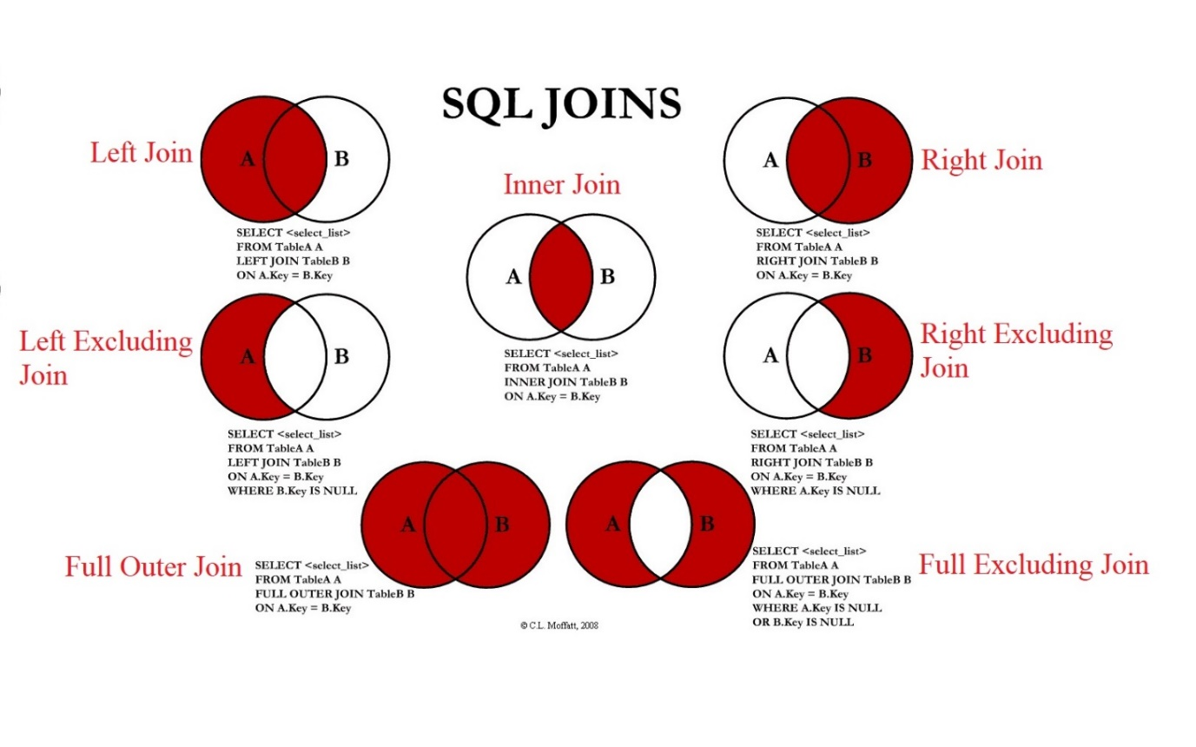
JOIN

Slide 6
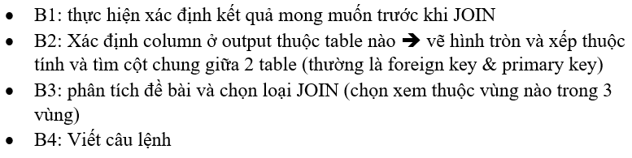
JOIN

Slide 7
JOIN syntax
INNER JOIN (JOIN)
    SELECT t1.column, t2.column
    FROM table1 t1
    JOIN table2 t2 ON t1.column = t2.column

Slide 8
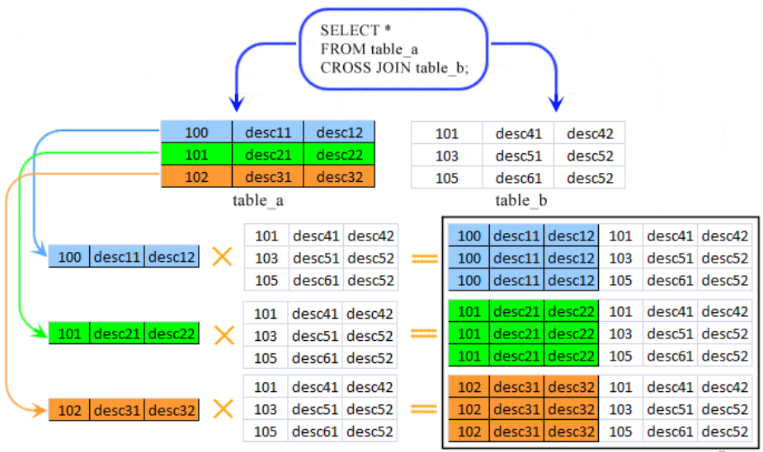
Cross JOIN
Cross JOIN

Slide 9
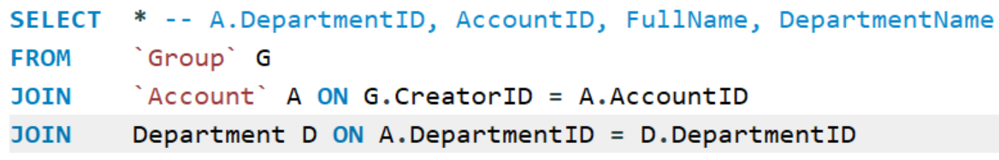
Example

Slide 10
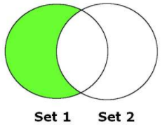
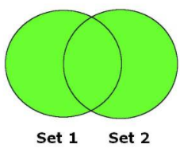
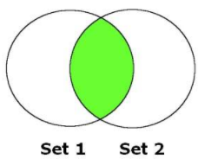
UNION
EXCEPT | Lấy những record nằm trong câu SELECT 1 mà không tồn tại trong câu SELECT 2
INTERSECT | Lấy các record chung giữa 2 table
UNION | Lấy các record Unique giữa 2 câu SELECT
UNION ALL | Giống UNION nhưng sẽ lấy tất cả các record của 2 câu SELECT

Slide 11
UNION Syntax
SELECT column_name_1, column_ name_2
FROM table_name_1
UNION | UNION ALL | INTERSECT | EXCEPT
SELECT column_name_3, column_ name_4
FROM table_name_2;
Notes:
https://gokhanatil.com/2010/10/minus-and-intersect-in-mysql.html

Slide 12
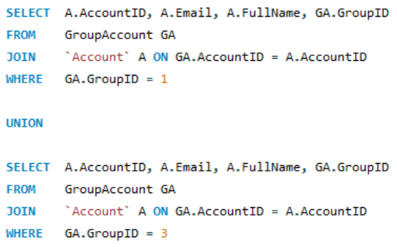
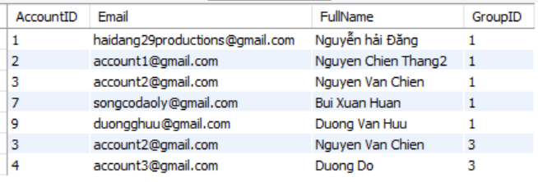
Example
Notes:
https://gokhanatil.com/2010/10/minus-and-intersect-in-mysql.html

Slide 13
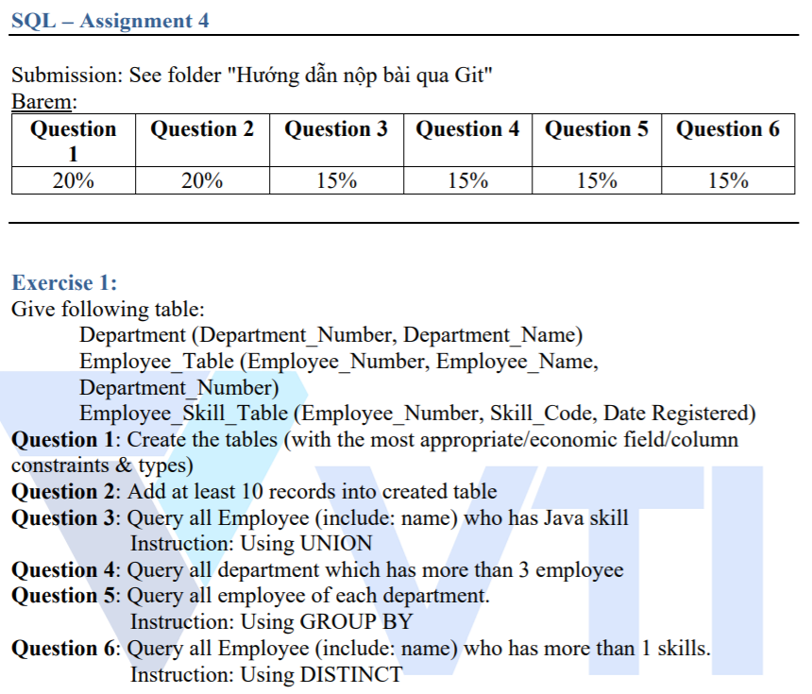
Assignments 1

Slide 14
Assignments 2
Assignments for Testing System

Slide 15
Q & A
Copyright © VTI Academy All Rights Reserved

